Slide 1
Visualization techniques for Multivariate data
Prof. Ramesh Ragala
VIT University
Chennai

Slide 2
Visualization Techniques for Multivariate Data
The visualization of data that does not generally have an explicit spatial attribute.
Multivariate (Multidimensional) Visualization
Visualization of datasets that have more than three variables
“Curse of dimension” is a trouble issue in information visualization
Most familiar plots can accommodate up to three dimensions adequately
The effectiveness of retinal visual elements (e.g. color, shape, size) deteriorates when the number of variables increases.
Categories of Multivariate Visualization Techniques
Different approaches to categorizing multivariate visualization techniques
The goal of the visualization, the types of the variables, mappings of the variables, etc.

Slide 3
Visualization Techniques for Multivariate Data
Few Categories are:
Geometric projection techniques
Icon-based techniques
Pixel-oriented techniques
Hierarchical techniques
Hybrid techniques

Slide 4
Visualization Techniques for Multivariate Data
Geometric Projection Techniques:
Visualization of geometric transformations and projections of the data
Examples:
Scatterplot matrix
Hyperbox
Trellis display
Parallel coordinates

Slide 5
Visualization Techniques for Multivariate Data
Scatter Plot:
It comes under category of Point-based technique
Point plots are as visualizations that project records from an N-dimensional data space to an arbitrary k-dimensional display space, such that data records map to k-dimensional points.
As the dimensionality of the data increases, the choices for visual analysis consist of:
Dimension Subsetting
Dimension Reduction
Dimension Embedding
Multiple Display → common approach is scatter matrix
Scatter Matrix: a grid of scatterplots → grid having N² cells, where N is the number of dimensions.

Slide 6
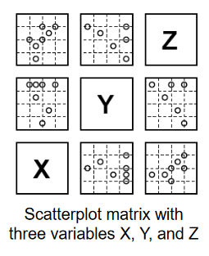
Visualization Techniques for Multivariate Data
Scatter Matrix:
Organizes all the pairwise scatterplots in a matrix format
Each display panel in the matrix is identified by its row and column coordinates
The panel at the i^{th} row and j^{th} column is a scatterplot of X_{j} versus X_{i}
The panel at the 3rd row (the top row) and 1st column is a scatterplot of Z versus X
Panels that are symmetric with respect to the XYZ diagonal have the same variables as their coordinates, rotated 90°
The redundancy is designed to improve visual linking
Patterns can be detected in both horizontal and vertical directions
Can only visualize the correlation between two variables, without using retinal visual elements or interaction techniques

Slide 7
Visualization Techniques for Multivariate Data
Trellis Display:
Display any one of the large variety of 1D, 2D and 3D plot types in a trellis layout of panels, where each panel displays the selected plot type for a level or interval on additional discrete or continuous
Panels are laid out into columns, rows and pages
Mapping of Variables
Axis Variables:
Mapped to one of the coordinates in the panels
Conditioning variable
Mapped to a horizontal bar at the top of each panel, representing one of its levels (discrete variable) or intervals (continuous variable)
Continuous variables have to be divided into intervals
The intervals are usually overlapped a little to improve the effectiveness of visualizing interrelationships
Superposed variable
Mapped to color or symbol of points in the panels

Slide 8
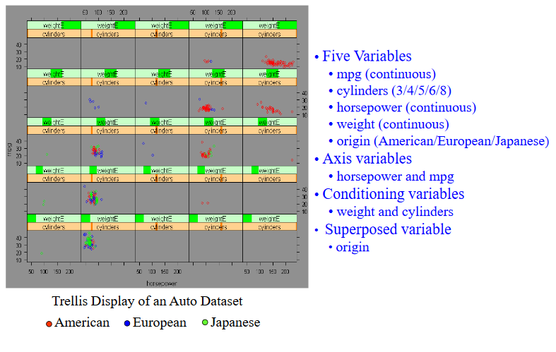
Visualization Techniques for Multivariate Data

Slide 9
Visualization Techniques for Multivariate Data
Trellis Display:
Effective in demonstrating the relationships between axis variables, considering all the conditioning variables.
What patterns can you see?
The generated visualization may be greatly affected by how the continuous conditioning variables are categorized
Data overlapping occurs when many data records have the same or similar values or the number of data points is large relative to the size of a panel

Slide 10
Visualization Techniques for Multivariate Data
Geometric Projection:
Can handle large and very large datasets when coupled with appropriate interaction techniques, but visual cluttering and record.
Can reasonably handle medium-and high-dimensional datasets
All data variables are treated equally; however, the order in which axes are displayed can affect what can be perceived
Effective for detecting outliers and correlation among different variables

Slide 11
Visualization Techniques for Multivariate Data
ICON Based Technique:
Visualization of data values as features of icons
Examples
Chernoff faces
Stick figures
Star plots
Color Icons

Slide 12
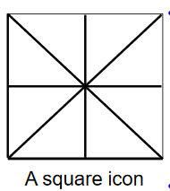
Visualization Techniques for Multivariate Data
Color Icons:
An area on the display to which color, shape, size, orientation, boundaries, and area subdividers can be mapped by multivariate data
Linear Mapping:
Up to 6 variables can be mapped to the icon, shown as the thick lines
2 of edges (one horizontal, one vertical)
2 diagonals
2 midlines
A color is assigned to each thick line according to the value of the corresponding variable
Area Mapping:
Each subarea (totally 8 subareas) corresponds to one variable
A color is assigned to a subarea according to the value of its corresponding variable

Slide 13
Visualization Techniques for Multivariate Data
Color Icons:
The number of variables mapped to the color icon can be tripled by having each variable control one of the hue, saturation, and value (HSV) values
Icons with different shapes can be used in place of the square icon
Example: Triangular, Hexagon

Slide 14
Visualization Techniques for Multivariate Data
Hierarchical techniques:
Subdivide the k-D data space and present subspaces in a hierarchical fashion
Examples:
Dimensional stacking
Mosaic Plot
Treemap
Cone Trees

Slide 15
Visualization Techniques for Multivariate Data
Dimensional Stacking:
Partition the k-D data space in 2-D subspaces which are stacked into each other
Adequate especially for data with ordinal attributes of low cardinality (the number of possible values)
Procedure:
Choose the most important pair of variables x_{i} and x_{j} , and define a 2D grid of x_{i} versus x_{j}
Recursive subdivision of each grid cell using the next important pair of parameters
Color coding the final grid cells
Using the value of a dependent variable, if applicable
Using the frequency of data in each grid cell

Slide 16
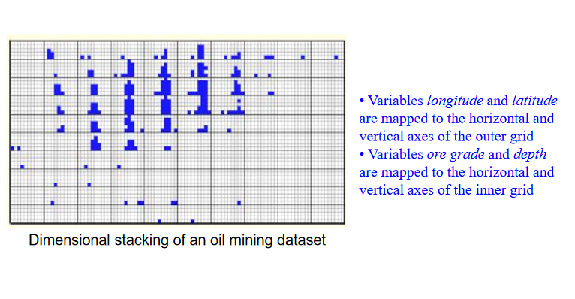
Visualization Techniques for Multivariate Data
Dimensional Stacking:

Slide 17
Visualization Techniques for Multivariate Data
Mosaic Plots:
A well-recognized visualization method for categorical variables
Shows frequencies in an m-way contingency table by nested rectangles
The area of a rectangle is proportional to its frequency (data counts)
Procedure:
First, divide a square in proportion to the marginal totals of variable X1 along the horizontal axis
Next, the rectangle for each category of X1 is subdivided in proportion to the conditional frequencies of variable X2 along the vertical axis
Then, the rectangle for each combination of categories of X1 and X2 is subdivided in proportion to the conditional frequencies of X2 along the horizontal axis.
Repeat subdivisions until all variables of interest have been included in the plot.

Slide 18
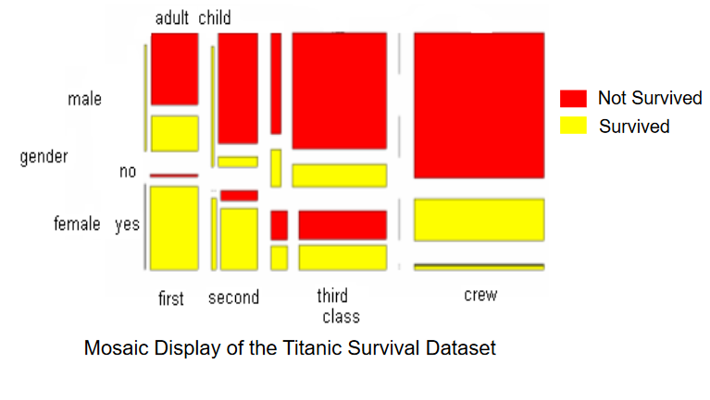
Visualization Techniques for Multivariate Data
Mosaic Plots:

